Slide 1
User Interface and Practice

Slide 2
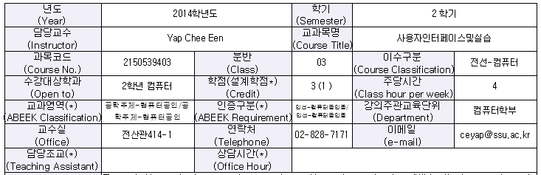
User Interface and Practice 2015

Slide 3
Course Overview
The goal of interaction between human and a machine at the User Interface(UI) is effective operation and control of the machine, and feedback from the machine which aids the operator in making operational decisions. UI programming introduces programming techniques for improving interfaces between computers and their users. We study graphical representation of the computer processing results based on the user’s requirements and menu oriented interaction graphics. We learn various UI programming techniques on Android environments and develop simple Android App.

Slide 4
Course Objectives
1. Introduction to Android and UI programming.
2. Program simple Android application using Java.
3. Program Android application and understand its event-based programming techniques.

Slide 5
Timetable
Monday | Tuesday | Wednesday | Thursday | Friday
 |  |  |  | OOP (나) 9-11am
 |  |  |  | 21202(Lecture)
 | UI (가) 11-1pm |  |  | UI (가) 11-1pm
 | 21201(Lecture) |  |  | 21205(Lab)
UI (나) 3-5pm
21205(Lab) | UI (라) 4.30-6.30pm | UI(다) 4.30-6.30pm |  | UI (라) 4.30-6.30pm
UI(다) 5-7pm | 21205(Lab) | 21202(Lecture) |  | 21201(Lecture)
21205(Lab)

Slide 6
Textbook
How to program, Android, Paul Deitel, Harvey Deitel, Abbey Deitel, Pearson, 2010
ISBN: 978-0-13-299054-7
Introduction to Android Application Development, Joseph Annuzzi, 4th edition, Pearson
ISBN-13:978-0-321-94026-1
Reference Book:
2. Title : Android User Interface development, PACKT publisher,2011 Author :Jason Morris ISBN: 978-1-849514-48-4

Slide 7
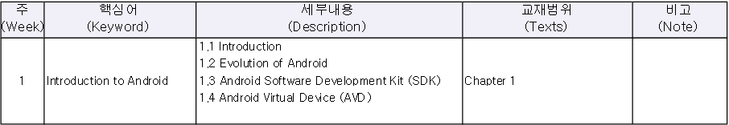
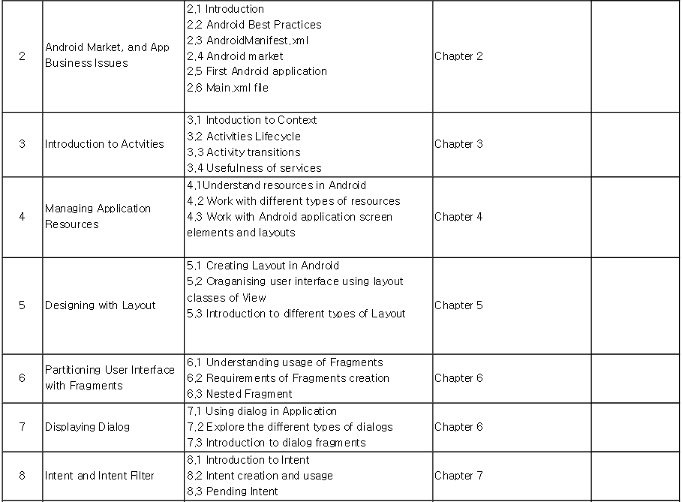
Course Outline

Slide 8
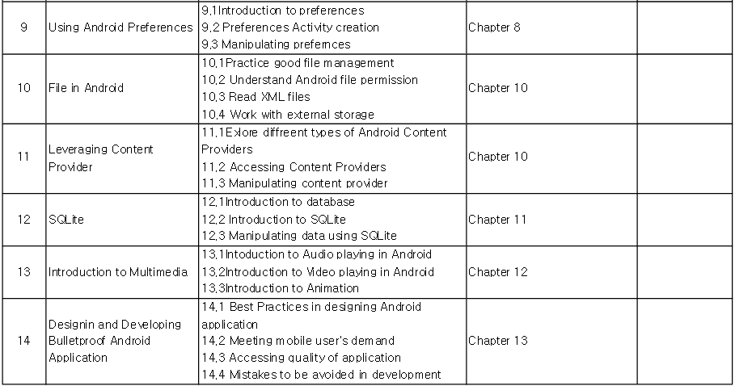
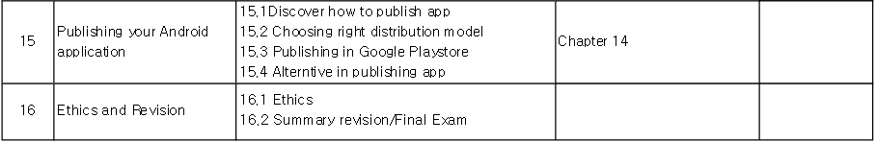
Course Outline

Slide 9
Course Assessment
COMPONENT | MARK DISTRIBUTION
FINAL EXAM | 25%
TEST | 25%
ASSIGNMENT | 25%
HOMEWORK/EXERCISE | 20%
ATTENDANCE | 5%

Slide 10
Important Dates
WEEK | TASK
WEEK 8 | TEST 1
WEEK 15 | TEST 2
WEEK 14 | ASSIGNMENT PRESENTATION
WEEK 16 | FINAL EXAM

